Slide 1

Going Beyond Allyship: Allies, Accomplices, and Co-conspirators

Slide 2
Allies
“An ally is someone from a nonmarginalized group who uses their privilege to advocate for a marginalized group. They transfer the benefits of their privilege to those who lack it.” (Phillips, 2020)
“Allies are members of the advantaged group who act against the oppression(s) from which they derive power, privilege, and acceptance. Their role as change agents, working with other privileged group members or in coalition with targeted group members to challenge systems of oppression, is an essential aspect of eliminating inequality.” (Adams, Bell, & Griffin, 2007, p. 47)
Notes:
https://forge.medium.com/performative-allyship-is-deadly-c900645d9f1f

Slide 3

Performative Allyship
“Performative allyship is when someone from that same nonmarginalized group professes support and solidarity with a marginalized group in a way that either isn’t helpful or that actively harms that group. Performative allyship usually involves the “ally” receiving some kind of reward — on social media, it’s that virtual pat on the back for being a “good person” or “on the right side.”” (Phillips, 2020)
Notes:
https://forge.medium.com/performative-allyship-is-deadly-c900645d9f1f

Slide 4
Accomplices
Uproot Racism
Eradicate White Supremacy
The actions of an accomplice are meant to directly challenge institutionalized racism, colonization, and White supremacy by blocking or impeding racist people, policies, and structures.
Notes:
https://www.whiteaccomplices.org/

Slide 5
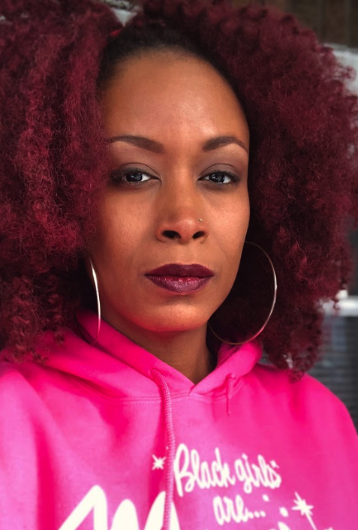
Co-conspirators
“I am not interested in white allies. What we need are co-conspirators. The definition of allyship is to mutually benefit and support. Black people are not obligated to provide support to people who are dominant. We are not working together on a mutual goal. My goal is to live. You don’t have that same goal. What I need is for people to come and work with us in the trenches and be there alongside us. It’s not about being on the outside and saying ‘yes, I support you!’ It’s about ‘not only do I support you, but I am here with you, I am rolling up my sleeves. What do I need to do?”
Feminista Jones, activist and the author of "Reclaiming Our Space--How Black Feminists are Changing the World from the Tweets to the Streets."
Notes:
https://www.theguardian.com/world/2015/jun/26/how-white-americans-can-fight-racism

Slide 6
Actor
Ally
Accomplice/ Co-conspirator
Listen to the voices of BIPOC community
Stay accountable to BIPOC community
Act in solidarity

Slide 7
Break-out Room Options
Draft a letter to elected officials (the mayor, city council, etc)
Draft a letter to the university president and provost
Draft a letter to the superintendent, school board, principals
Draft a letter to the Chamber of Commerce or business council
Discuss scenarios from our last community meeting
Link for writing letters: https://docs.google.com/document/d/1rEdzV8UT3UGtpl6sHcyqCdd4bfu8Yz6vtvGdn0oMw4w/edit?usp=sharing
Teaching for Diversity and Social Justice, Second Edition, Routledge

Slide 8
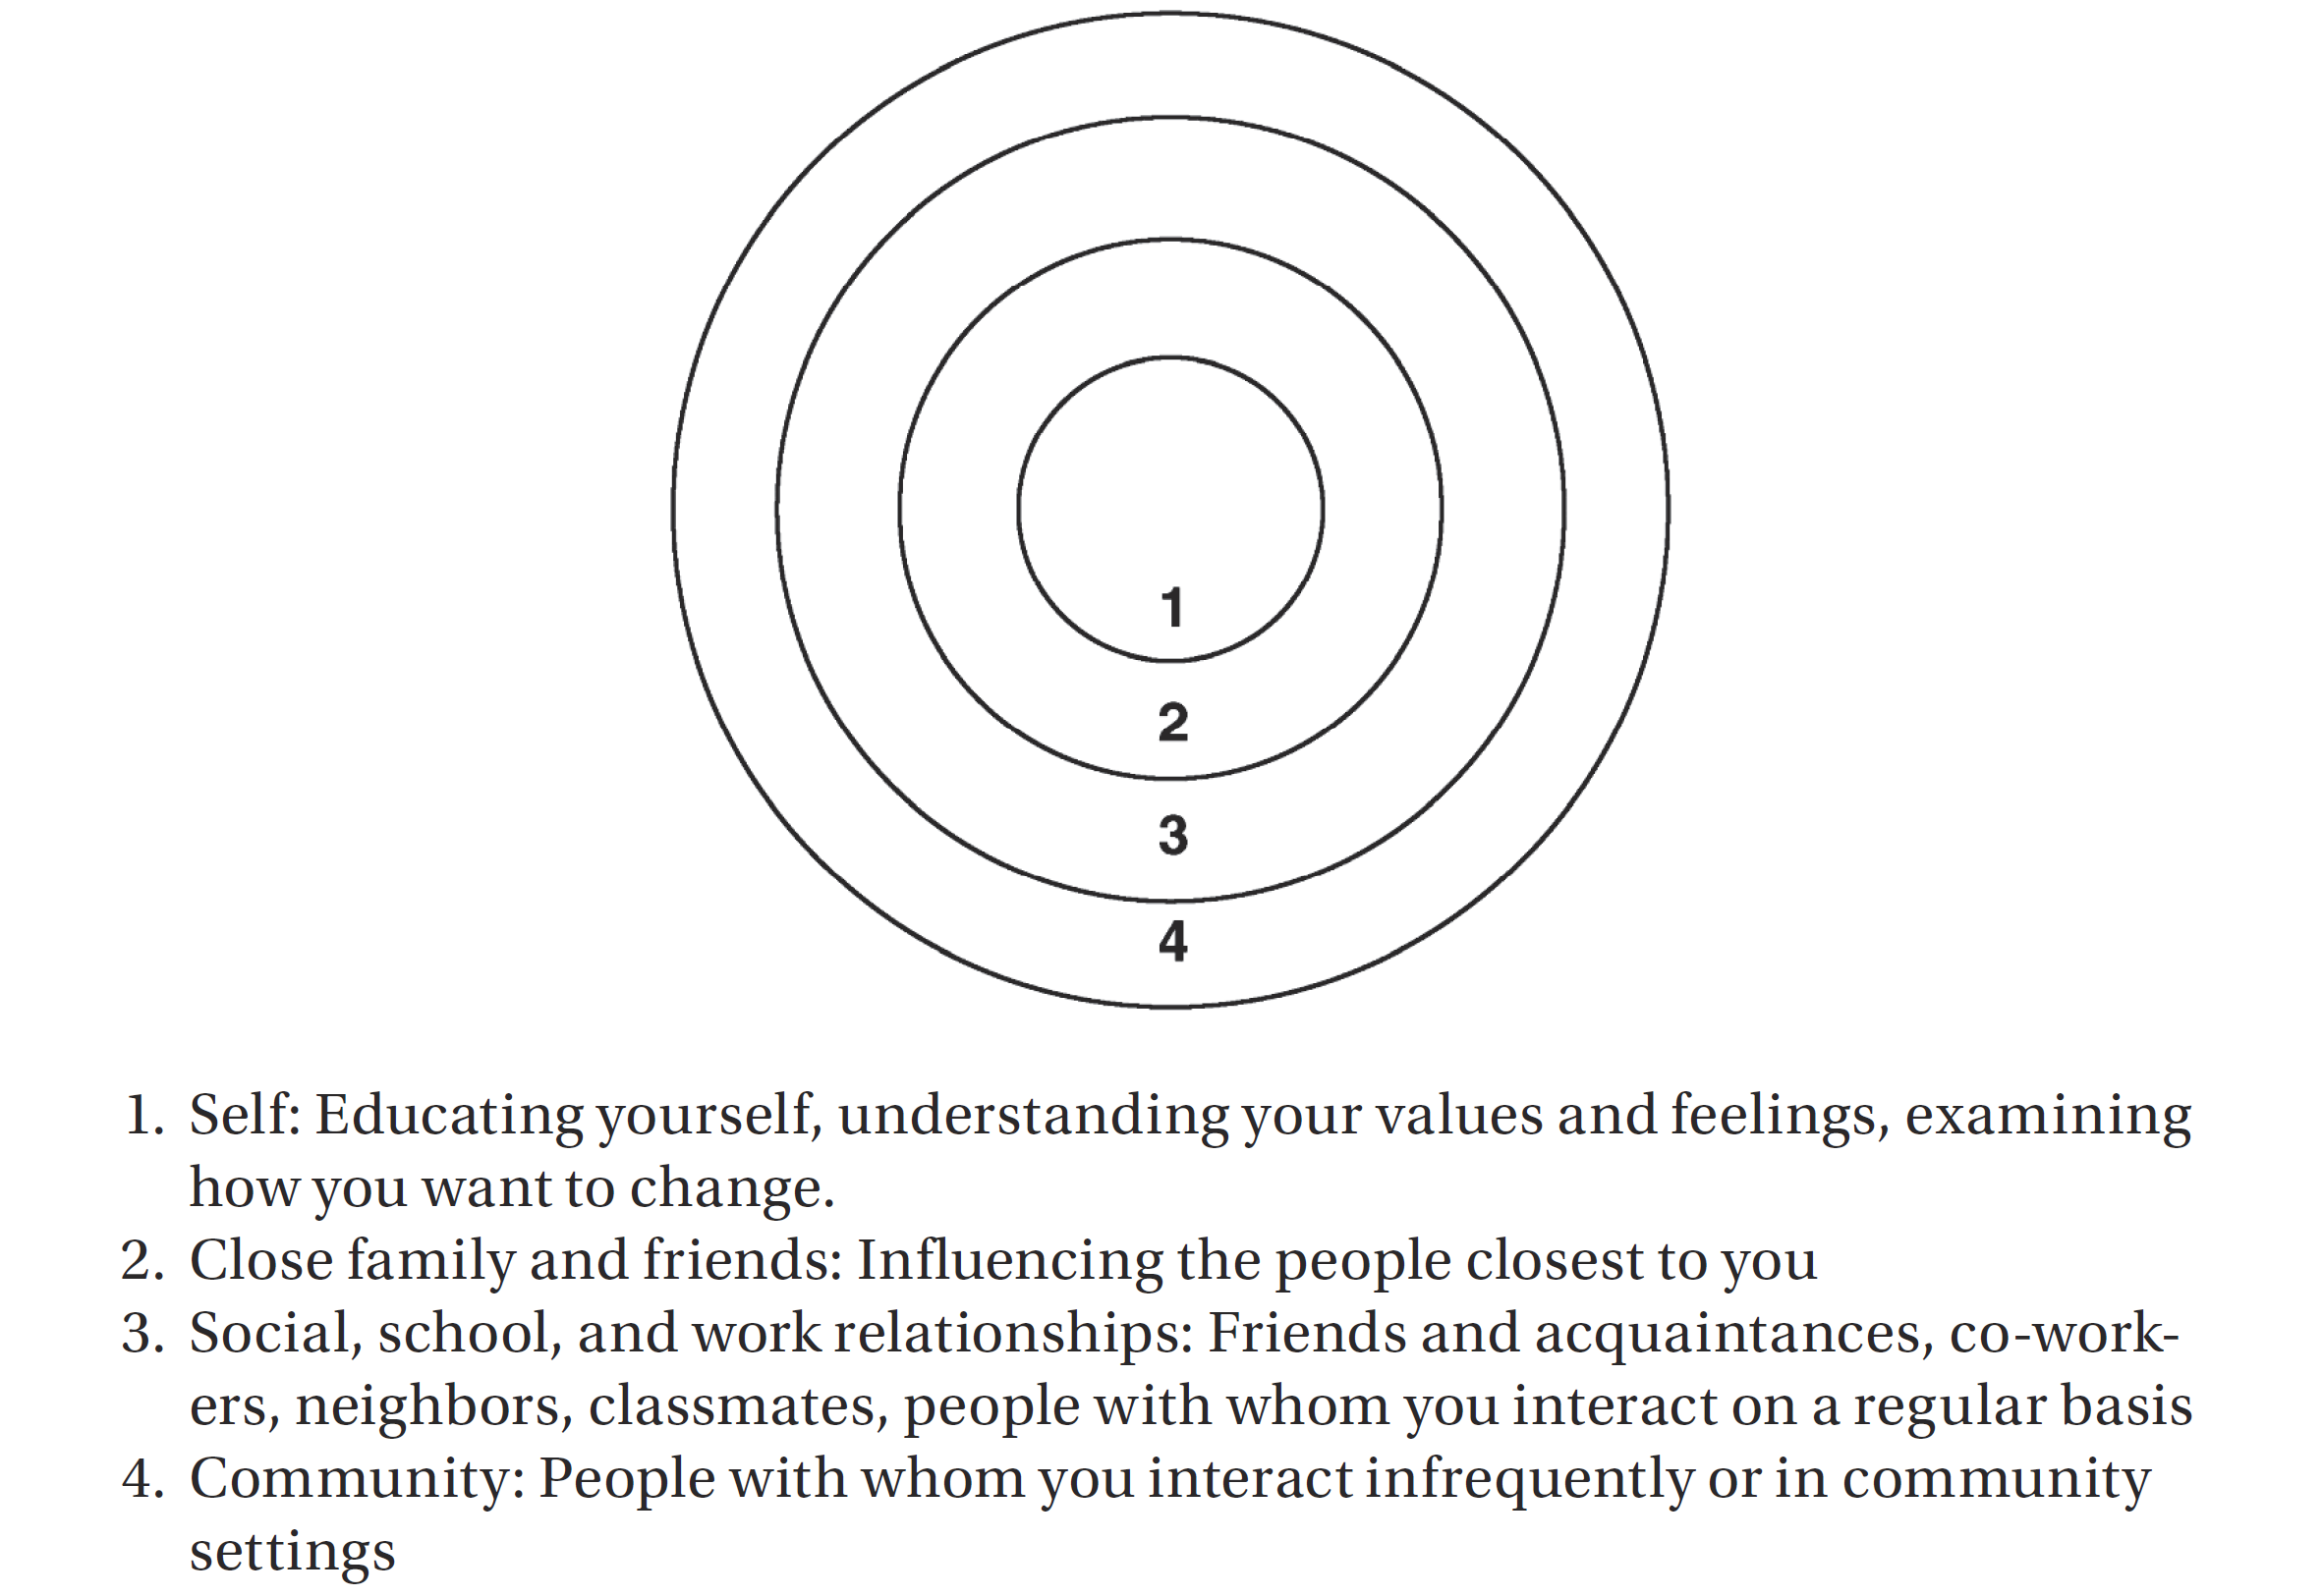
Spheres of Influence
Teaching for Diversity and Social Justice, Second Edition, Routledge

Slide 9
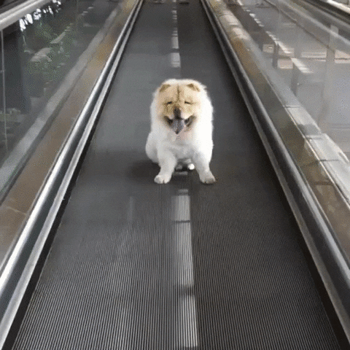

Slide 10

ACT NOW
Encourage those who experience or witness acts of hate towards the Asian American and Pacific Islander communities to report an incident at AAPI Hate website. Share safety tips with your friends and family on what to do if encountering or witnessing hate. Those are available on AAPI Hate website.
Be informed about what is happening and why.
Support with donation AAPI HATE and/or the Movement Hub, a platform that brings together 40 Asian American and Pacific Islander organizations across the U.S. that advance racial equity and intersectional justice.
Support local Asian-owned businesses. These businesses began seeing a decline in business even before the first case of coronavirus was confirmed in the U.S. and stay-at-home orders were enacted. [GOOGLE DOC]
https://stopaapihate.org/actnow/
Notes:
Links to Asian-run businesses - https://docs.google.com/document/d/1zRDQzEfFe_jN-9eSPfJ1LD_iX5rali7RZqFvKBzWcRc/edit?usp=sharing

Slide 11

ACT NOW
Ask your elected officials what they are doing to increase resources for survivors and their families, and for intervention- and prevention-based programs such as anti-racism education in schools and in communities.
Work with your workplace, school, faith-based institution, union, or community organization to issue a statement denouncing anti-Asian racism and to encourage everyone to work towards racial justice.
Demand ordinances or resolutions to condemn hate. Endorse strong civil rights laws at the local and state levels. What are the issues that exist within your community that need to be addressed?
Advocate for expanded civil rights protections that would safeguard Asian Americans and other people from harassment and discriminatory treatment in private businesses.
https://stopaapihate.org/actnow/
Notes:
https://docs.google.com/document/d/1rEdzV8UT3UGtpl6sHcyqCdd4bfu8Yz6vtvGdn0oMw4w/edit?usp=sharing

Slide 12
Scenarios to Consider: What would you do?
You are at a supermarket. You notice that a white woman has approached an Asian family. She is blaming them for the spread of COVID and is telling them loudly to go back to China.
You are walking in the street. You notice an Asian woman walking fast trying to move away from a white male following her and shouting obscenities at her.
You are at work. You observe a conversation where a white colleague is explaining to your Chinese colleague how to perform a basic work function. You realize that your Chinese colleague is an expert in that area and feels frustrated that he is being lectured in the basics of his job.
Your child/grandchild comes home and shares that some kids were calling a Korean boy in their school nasty names, making faces at him, and making fun of the lunch he brought from home. The teacher did nothing to address that.
You live in a community with a large proportion of Asian and Asian American families. You are not certain whether they are included in the decision-making processes in your community, such as the development of new HOA rules.
You live in a town that tends to downplay racist incidents and sweep them under the rug. You are not certain whether members of the Asian and Asian American communities feel safe and whether they have experienced any form of harassment.

Slide 13
Questions for Reflection
What action can you take to interrupt or combat Anti-Asian racism?
What resources or materials (people, space, information, etc.), if any, would you need to achieve your goal?
How can you access those resources?
What behaviors or steps on your part would taking this action entail?
What is a realistic timeline for carrying out the steps involved in this action plan?
What hazards or risks are involved? How can you address those risks?
What obstacles might you encounter?
What could you do to reduce or overcome these obstacles?
Adapted from Teaching for Diversity and Social Justice, Second Edition, Routledge

